Slide 1











CAPSTONE PROJECT
Phase B • 24-1-D-36
AI-Driven Web App for Dietary Restricted Individuals
Supervisor - Dr. Natali Levi
Ilanit Azran - 208657320
Noy Biton - 312238678
1
Notes:
Good morning, I’m Noy and this is Ilanit, and today we’re going to present our capstone project called “AI-Driven Web App for Dietary Restricted Individuals”.

Slide 2



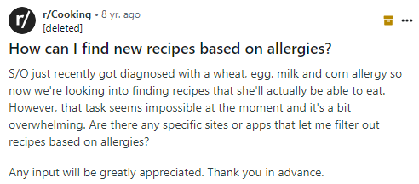
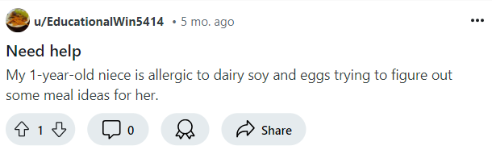

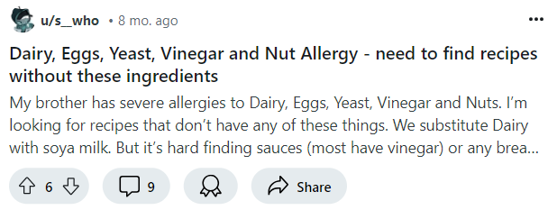

2
Notes:
As you can see, all of these people looking for help to find recipes that meet their diverse dietary needs.
for example, this woman is looking for a recipe for a gluten free, egg free and nut free cake.
These people, has a limited supply of ingredients they can eat, and therefore they experience difficulties on a daily basis in recipe searching.

Slide 3



CURRENT SOLUTIONS
Diet tracking and categorization of recipes under specific dietary labels.
Recipe recommendations app
Dietary discussions on dedicated forums
Group posts on social media
3
Notes:
in the digital era we live in there are many solutions for diet and recipe management, like My Fitness Pal, Yummly and discussions on social media, but for these people struggling with their diet it is just (CLICK) not enough.

Slide 4
CURRENT SOLUTIONS
Not Enough
4
Notes:
So, My Fitness Pal might fit people who aim to lose weight, but its features are not enough for those with multiple dietary restrictions.
We also have Yummly that has algorithmic inconsistencies when filtering out allergens, even when stating dietary preferences explicitly.
Social media is often based on personal experiences rather than expert guidance, and searching through posts is inconvenient. Also, the response time for recipe requests is long since it depend on user availability and group moderation.

Slide 5


EatExact
OUR SOLUTION: EATEXACT
Generating tailored recipes for complex dietary needs using AI
Save, edit and share recipes easily
System learns user preferences by managing Settings
Dynamic, user-friendly interface
Individuals and families with dietary restriction, professional chefs and nutritionists.
Transforming dietary management into manageable daily routine
5
Notes:
Now we will present our solution called EatExact. EatExact is a web application with a convenient and user-friendly interface that generates recipes using AI, according to user needs. As you can see, we focused on creating personalized recipes and managing them in the system as well as the ability to managing Settings, so the system learns user's preferences for further uses. our audience is Individuals and families with dietary restrictions, chefs and nutritionists.
נוטרישניסטס

Slide 6
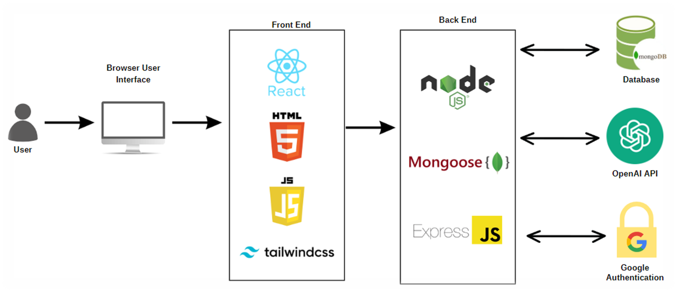
SYSTEM ARCHITECTURE
6
Notes:
Here is the system architecture diagram, as you can see we used client-server architecture, and connections to external services like mongoDB database and API to ChatGPT.
Next, we will talk about the technologies we see in the diagram in detail.

Slide 7


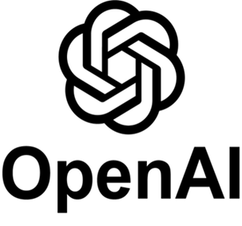
TECHNOLOGIES & TOOLS
NoSQL database uses JSON-like documents. flexible, scalable, fast and easy to deploy.
Used for user management, saving favorite recipes and managing family members data and preferences as well as patients and menus
Provides access to ‘GPT-4’, that able to generate human-like text.
Used for generating recipes based on input given by the user
Developing our platform as a single-page web application. Technologies like React, Tailwind, node.js used for designing an interactive user interface
7
Notes:
So, for the database service we will use MongoDB which is a No-SQL database that uses JSON-like documents. It is flexible, scalable, fast and easy to deploy, and we will use it for user management, saving favorite recipes and managing user taste preferences.
We will also use one of the popular large language models in the market nowadays which is OpenAI Chat-gpt, and we will use its ‘gpt-4’ API for generating recipes.
The main tools we used in the development process are web application tools in order to develop our single-page web application. We used react and tailwind for the frontend, and for node.js for the backend.

Slide 8

SUCCESS MEASURES
Generating Recipes
Achieved by integrating OpenAI's ChatGPT API
Creating recipes based on user input and pre-saved preferences
Dietary Restrictions Compliance
Ensured users received appropriate recipes free from harmful ingredients
Implemented well-crafted prompts guiding AI to consider user preferences and dietary needs
Variety in Recipe Options
Enabled users to generate and save multiple recipes in each category
Offered limitless culinary options to meet diverse dietary requirements
8
Notes:
The success of our project was measured against several criteria. One of our primary goals was to actually generate responses through AI API based on user input and preferences, and we successfully achieved this goal by integrating OpenAI's ChatGPT API.
We also ensured that users requesting recipes without harmful ingredients actually received appropriate responses, thanks to well-crafted prompts guiding the AI to consider dietary restrictions and preferences.
Lastly, it was important to us to give our users a variety of culinary options, so each time they wish to use our app, they can input different criteria and get limitless options of recipes.

Slide 9

CHALLENGES
Prompt Quality for AI Responses
Early prompts generated irrelevant or low-quality recipes
Formatting Issues in Recipe Display
Initial AI responses included undesired formatting
Tailoring AI for Different User Roles
Needed distinct prompts for Individual, Professional, and Dietitian users
Handling Repetitive Code
Addressed by creating reusable components to streamline development
Real-Time State Updates in React
Overcame delayed UI updates using useState and useEffect
9
Notes:
During the development process, we faced many challenges, and here are the key challenges we had:
So first, we got poor responses from the api because the first versions of the prompts we used weren't good enough. we overcame it by perfecting our prompts until we got satisfying responses.
Another challenge we had is that the response from chat gpt were formatted with marks like asterixis that didn't match html formatting like bold text, for example. So we had to request for a specific formatting from the api.
We also faced the challenge of different account types, like individual, professional and dietitian. so we solved it by creating different prompts for each account type, since they have different needs.
Another significant challenge is handling the amount of code repeating across different pages. Our website has uniform design which causes repetitions. We managed to reduce it by creating reusable react components across different pages.
Last key challenge is handling Real-Time State Updates in our application, for example selecting user input and inserting it to the prompt in real time. we managed to do so by using useState and useEffect hooks in React.

Slide 10
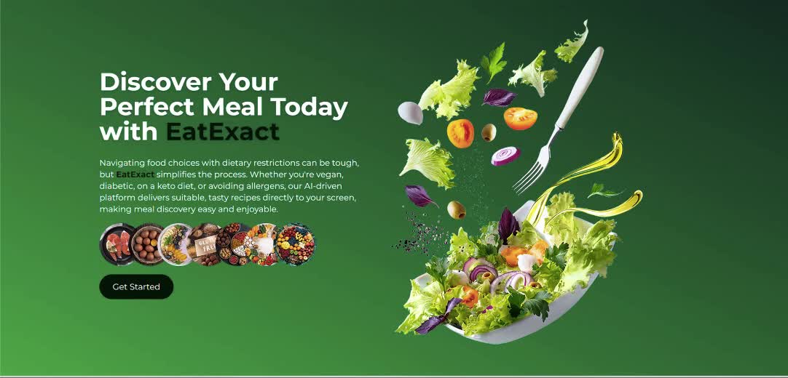
WEBSITE DEMO
10

Slide 11

EatExact
THANK YOU FOR LISTENING!
11

